Slide 1

DIGITAL DESIGN AND COMPUTER ORGANIZATION
Direct Memory Access T2 Chapter 4: 4.4
Team DDCO Department of Computer Science and Engineering

Slide 2

Introduction
Processor–I/O Data Transfer
Data between processor and I/O devices is transferred using instructions like MOVE DATAIN, R0
Processor checks device readiness before transfer:
By polling the device’s status flag, or
Waiting for an interrupt request from the device.
Each data word transfer involves multiple instructions, causing high overhead:
Polling the status register
Incrementing memory addresses
Keeping track of word counts
Interrupt-based I/O adds extra overhead for saving/restoring:
Program counter and processor state information
For large data transfers, a faster alternative is used:
A special control unit (e.g., DMA – Direct Memory Access) handles block transfers directly between I/O device and memory.

Slide 3
Introduction
Direct Memory Access (DMA) allows data transfer directly between an I/O device and main memory without continuous processor intervention.
DMA transfer is managed by a special control circuit in the I/O interface — the DMA Controller.
The DMA controller performs tasks usually handled by the processor when accessing memory.
For each word transferred, it:
Provides the memory address.
Generates all bus control signals for data transfer.
Since data is transferred in blocks, the DMA controller:
Increments the memory address for each successive word.
Keeps count of the number of transfers completed.

Slide 4
Operation
To initiate a DMA transfer, the processor sends the starting address, word count, and direction of transfer to the DMA controller.
Once started, the DMA controller transfers the entire block of data autonomously.
When the transfer completes, the controller raises an interrupt to inform the processor.
During the DMA transfer, the processor can execute another program, improving system efficiency.

Slide 5
DMA Controller
The DMA controller contains registers for:
Starting address
Word count
Status and control flags
The R/W bit determines the direction (read from memory or write to memory).
The Interrupt Enable (IE) bit, when set, causes the controller to generate an interrupt after the transfer.
The Done flag indicates completion, and the IRQ bit shows an interrupt request has been sent.

Slide 6
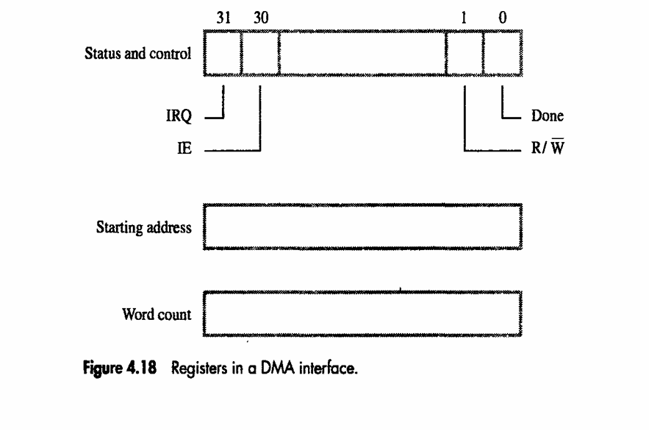
DMA Controller

Slide 7
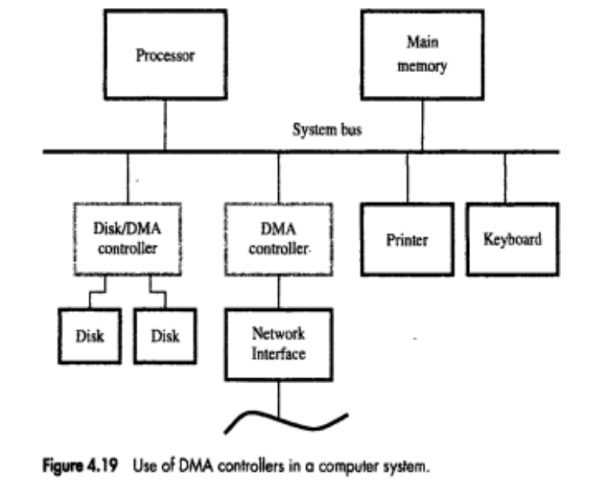
DMA Controller

Slide 8
DMA Controller
A DMA controller connects high-speed devices (like disks or networks) to the computer bus.
A disk controller may handle multiple disks, each with its own DMA channel — enabling independent transfers.
Each channel has its own registers to store:
Memory address
Word count
Control information

Slide 9
DMA Controller
Steps in DMA Operation
Program initialization:
CPU writes memory address and word count into DMA channel registers.
Disk controller also receives identifying info about the data to transfer.
Independent operation:
DMA controller handles data transfer autonomously, without CPU intervention.
Completion & status update:
On completion, the Done bit in the control register is set.
If interrupts are enabled (IE bit), an IRQ signal is sent to notify the processor.
Status register logs transfer success or errors.

Slide 10
System Integration
DMA controllers can be part of devices like disk controllers or network interfaces, each with independent DMA channels.
Memory access by the processor and DMA controllers is interleaved, with DMA given higher priority for bus access.
This process of sharing memory access is called cycle stealing.
In burst (block) mode, the DMA controller gets exclusive access to memory for faster transfer.

Slide 11
Why do we need DMA?
The assumption about the I/O machines like keyboards, mouse, and printer etc. are genuinely very slow when compared with the central processing unit (CPU).
To overcome this issue an interrupt handler was used and the I/O machine produces all the signals that the CPU produce, then the I/O machine can bypass the information alienates to central processing unit and hence increases the speed.

Slide 12
Why do we need DMA?
Cycle Stealing Process: Traditionally it is a method of accessing RAM or bus without interfering with the CPU.
DMA allows I/O controllers to read or write RAM without CPU intervention.
Clever exploitation of specific CPU or bus timings can permit the CPU to run at full speed without any delay if external devices access memory not actively participating in the CPU's current activity and complete the operations before any possible CPU conflict.
Such systems are nearly dual-port RAM without the expense of high speed RAM.
Most systems halt the CPU during the steal, essentially making it a form of DMA by another name.

Slide 13
Bus Arbitration
DMA reduces processor overhead by eliminating the need to execute multiple I/O instructions per word transferred.
An arbitration mechanism ensures that bus conflicts between the processor and multiple DMA devices are resolved efficiently.

Slide 14
Bus Arbitration
Bus Master & Bus Arbitration:
The device that controls data transfer on the bus is called the Bus Master.
When the current master finishes, control passes to another device.
Bus Arbitration is the process of selecting the next bus master.
Arbitration ensures orderly and prioritized access to the bus among devices.
Types of Bus Arbitration
Centralized Arbitration
A single bus arbiter manages and grants bus access. Simpler control and predictable priority system.
Distributed Arbitration
All devices participate in choosing the next bus master. Removes single-point dependency; supports more flexibility.

Slide 15
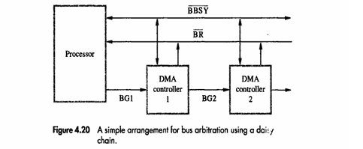
Bus Arbitration- Central Arbitration
Bus Arbiter: May be the processor or a separate control unit that manages access to the system bus.
Bus Master: The device currently controlling the bus (CPU or DMA controller).
Bus Request (BR): DMA controller requests bus control by asserting the BR line.
Bus Grant (BG): Processor responds with a BG signal → indicates permission to use the bus.
Daisy-chain connection:
BG1 output of one DMA connects to BG2 input of the next.
If DMA 1 is requesting, it blocks BG signal to lower-priority devices.
Ensures a priority-based sequence of control.
Bus Busy (BBSY): When DMA gets control, it asserts BBSY to inform others that the bus is occupied.

Slide 16
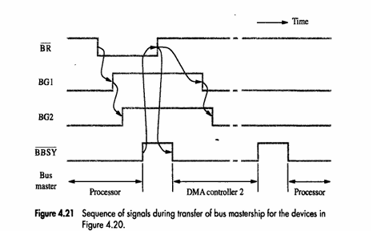
Bus Arbitration- Central Arbitration
Sequence of Bus Mastership (from timing diagram): 1️⃣ Processor releases the bus. 2️⃣ DMA 2 requests (BR asserted). 3️⃣ Processor issues BG; DMA 2 waits for BBSY = 0. 4️⃣ DMA 2 assumes bus mastership → sets BBSY = 1. 5️⃣ Performs data transfer (cycle stealing / block mode). 6️⃣ After completion, DMA 2 releases bus → BBSY = 0 → processor regains control.
Priority Control Methods:
Fixed Priority: e.g., BR1 > BR2 > BR3 > BR4 (BR1 highest).
Rotating Priority: After a device is served, its priority moves to lowest (next order: 2, 3, 4, 1).
Provides flexibility and fairness in servicing multiple DMA requests.

Slide 17
Bus Arbitration- Distributed Arbitration
Definition: All devices share equal responsibility for deciding who becomes the bus master — no central arbiter is required.
How it works:
Each device has a unique 4-bit ID number.
When requesting the bus, devices:
Assert a Start-Arbitration signal.
Place their ID number on 4 arbitration lines (ARB0–ARB3).
The bus logic compares all IDs simultaneously.
The device with the highest ID wins control of the bus.
Open-Collector Lines:
Drivers use open-collector (O.C.) outputs, allowing wired-OR logic.
If any device drives a ‘0’ on a line, the bus line reads ‘0’.
Ensures that logic 1 loses to logic 0 — effectively implementing priority.

Slide 18
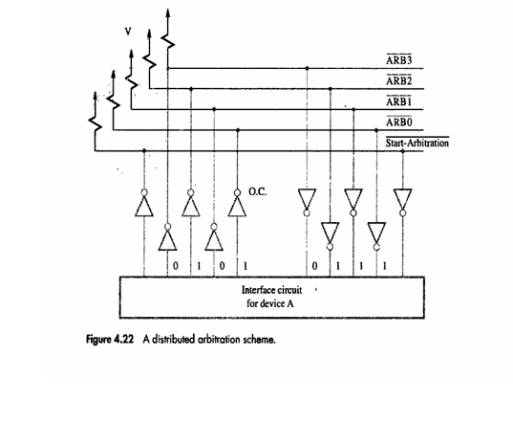
Bus Arbitration- Distributed Arbitration

Slide 19
Bus Arbitration- Distributed Arbitration
Distributed Arbitration – Example & Advantages
Example (Device A: ID=0101, Device B: ID=0110):
Both request the bus → IDs placed on lines.
Combined pattern seen = 0111.
Devices compare bit-by-bit (MSB first):
At bit 1, A sees mismatch → disables its lower bits (ARB1, ARB0).
B continues → wins arbitration (higher ID = 6).
Temporary disables are re-enabled after bus control resolves.
Advantages: ✅ No single-point failure — no central arbiter needed. ✅ Higher reliability and scalability for multiple devices. ✅ Used in SCSI bus and other high-reliability systems.

Slide 20
MCQ
In a DMA transfer, the role of the CPU is to: a) Transfer data between I/O and memory directly b) Provide the starting address and control to the DMA controller, then get interrupted after transfer c) Continuously poll the device for data readiness d) Perform all I/O operations itself
In a system using cycle stealing DMA, which statement is correct? a) CPU is completely halted during DMA transfer. b) CPU and DMA share bus cycles — DMA steals one memory cycle at a time. c) CPU executes only I/O instructions during DMA transfer. d) DMA controller uses dual-port RAM.

Slide 21
MCQ
In a DMA transfer, the role of the CPU is to: a) Transfer data between I/O and memory directly b) Provide the starting address and control to the DMA controller, then get interrupted after transfer c) Continuously poll the device for data readiness d) Perform all I/O operations itself
Answer: (b) Explanation: CPU initializes DMA by giving starting address, word count, and direction. After completion, the DMA controller interrupts the CPU.
In a system using cycle stealing DMA, which statement is correct? a) CPU is completely halted during DMA transfer. b) CPU and DMA share bus cycles — DMA steals one memory cycle at a time. c) CPU executes only I/O instructions during DMA transfer. d) DMA controller uses dual-port RAM.
Answer: (b) Explanation: In cycle stealing, DMA “steals” one memory cycle from the CPU, allowing CPU execution in the remaining cycles.

Slide 22
MCQ
In a daisy chain priority scheme used for bus arbitration, which statement is true? a) Highest priority device is closest to the processor. b) Lowest priority device is closest to the processor. c) All devices have equal priority. d) Bus grant signal propagates from lowest to highest priority device.
In distributed arbitration, a) A single bus arbiter assigns bus mastership. b) Each device compares its ID on arbitration lines and highest ID wins. c) Lowest ID device wins control. d) Arbitration depends on interrupt priority levels.

Slide 23
MCQ
In a daisy chain priority scheme used for bus arbitration, which statement is true? a) Highest priority device is closest to the processor. b) Lowest priority device is closest to the processor. c) All devices have equal priority. d) Bus grant signal propagates from lowest to highest priority device.
Answer: (a) Explanation: Bus grant passes sequentially through devices; the nearest device has highest priority.
In distributed arbitration, a) A single bus arbiter assigns bus mastership. b) Each device compares its ID on arbitration lines and highest ID wins. c) Lowest ID device wins control. d) Arbitration depends on interrupt priority levels.
Answer: (b) Explanation: All devices participate by putting their 4-bit IDs on shared arbitration lines. Highest ID wins the bus.

Slide 24
THANK YOU
Team DDCO Department of Computer Science and Engineering

